Slide 1

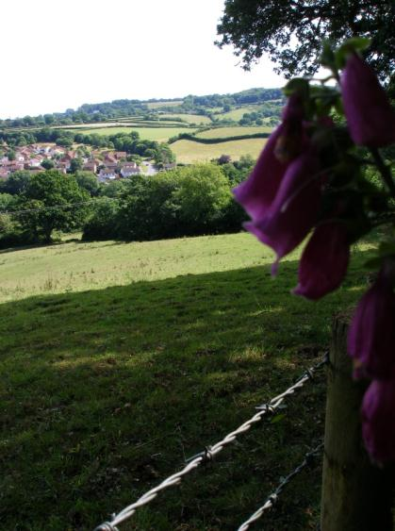
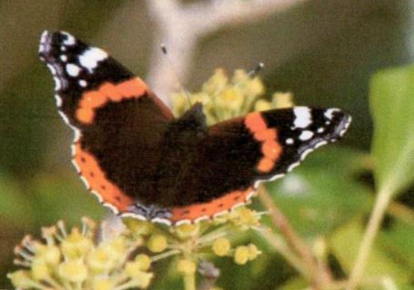
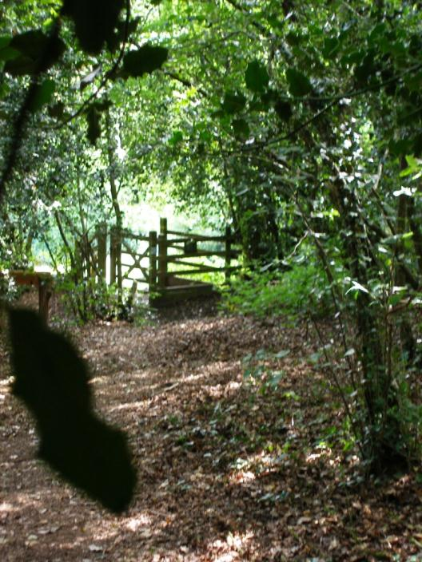
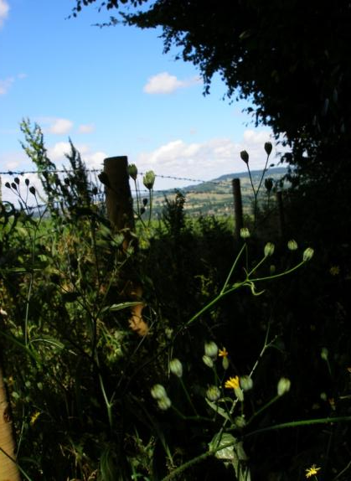


A walk around
Roundball Wood

Slide 2
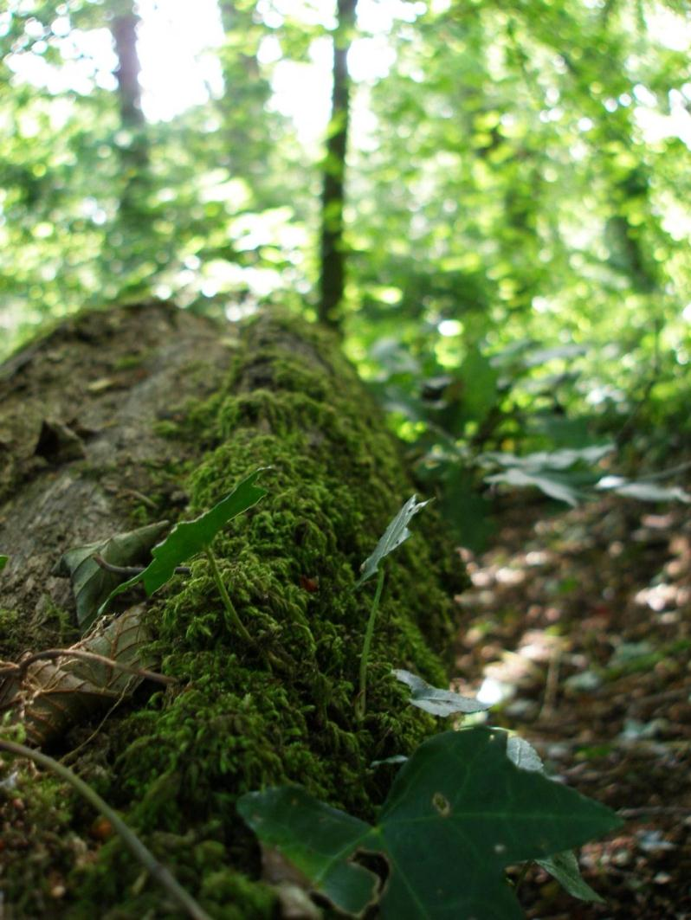
Introduction
Roundball Wood is a pretty, self-contained area of woodland situated to the south of Honiton within the East Devon Area Of Outstanding Natural Beauty.
The wood has been managed by Honiton Town Council since 1998 but dates back to 1840 where it is featured in the Tithe Records. However the magnificent old oak trees are about 200 years old. This means the wood is classed as semi-ancient wet woodland.
Visit:
www.eastdevonaonb.org.uk
To see the digital maps and records.

Slide 3
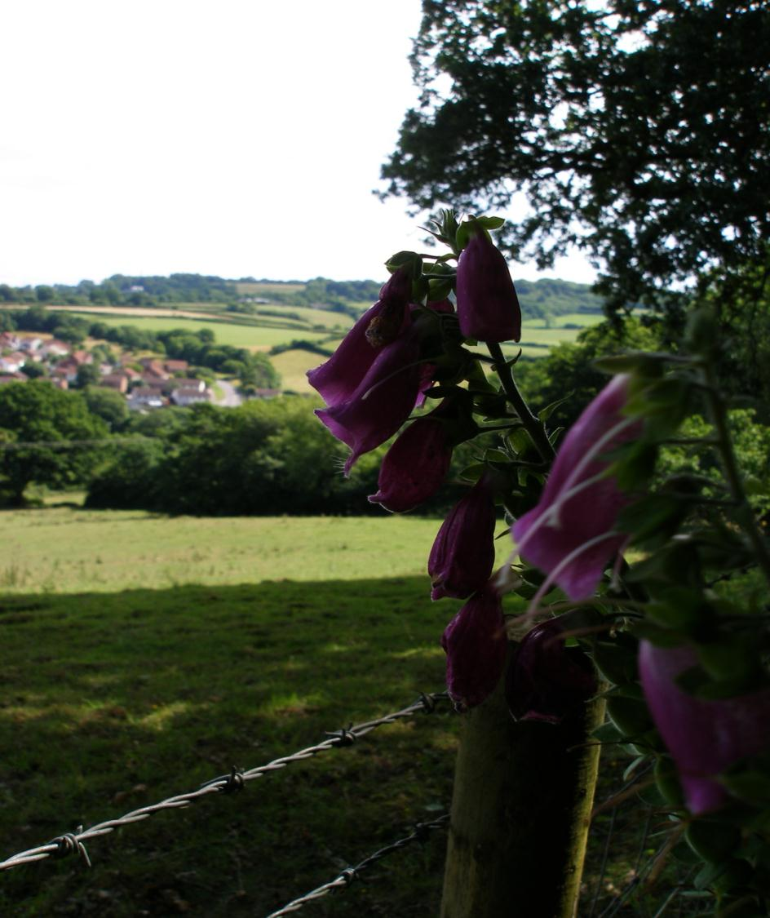

Slide 4
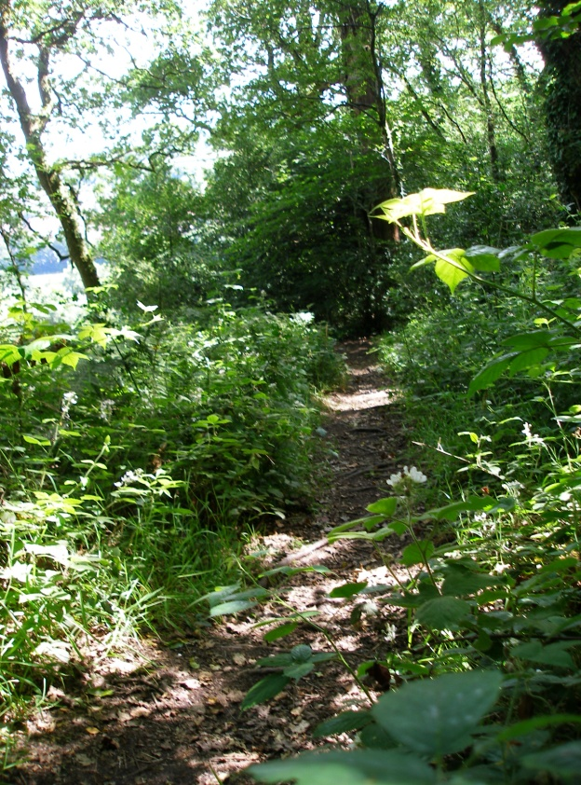
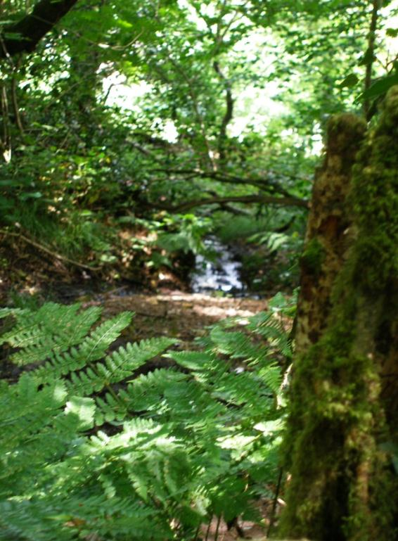

Slide 5
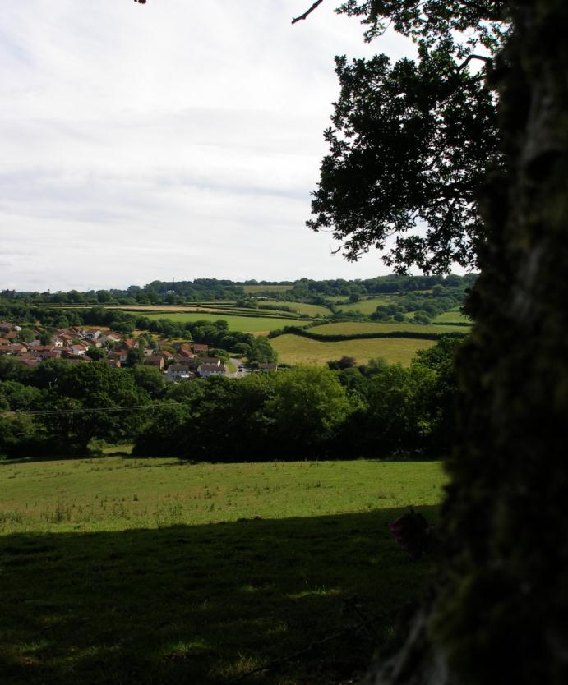
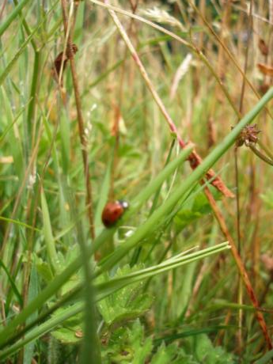

Nature Trail
Roundball Wood is home to many different animals and plants, most can be spotted and observed from the paths however some of the mammals are nocturnal and very shy.
There are 8 Nature stations to look out for on your walk.
1- Dead tree
2- Old coppice
3- Badger’s Beech
4- Wood interior
5- Roundball Hill
6- Badger set
7- Mossy Boles
8- Fallen Birch
All of these play a vital role in the wood so keep your eyes peeled!

Slide 6

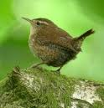

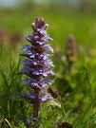
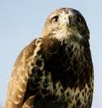


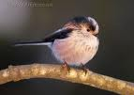

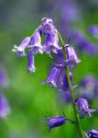
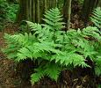

Wildlife
There are hundreds of species occupying the old wood; here are just some to look out for:
Common Spotted
Orchid
Jenny Wren
Great Spotted
Woodpecker
Bugle
Buzzard
Tawny Owl
Beech
Long Tailed Tit
Lady’s smock
Bluebell
Lady Fern
Chiffchaff

Slide 7
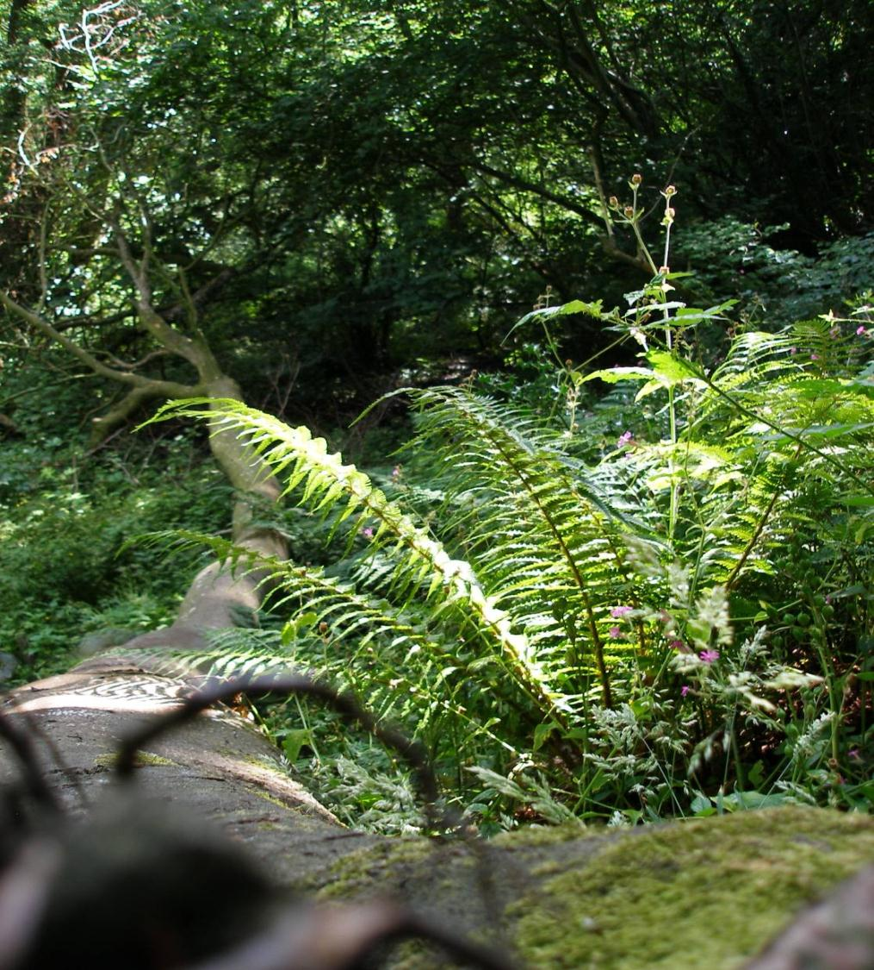

Slide 8
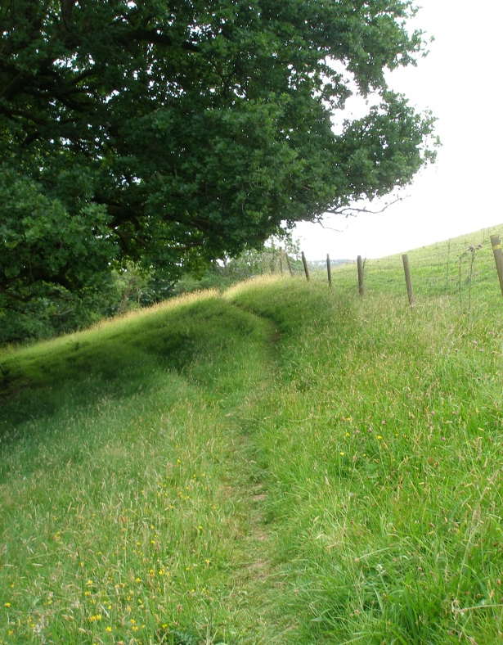
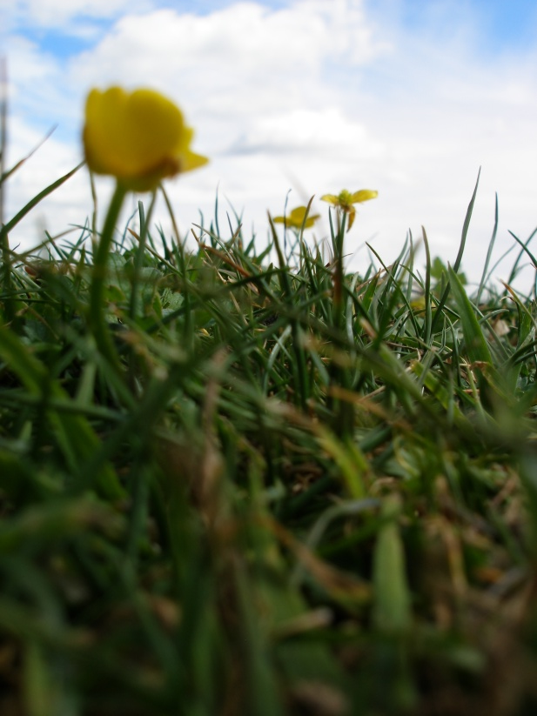
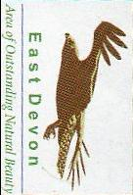

Slide 9
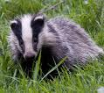



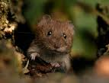
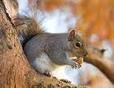


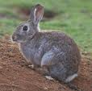
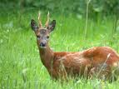
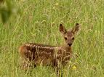


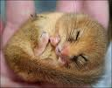
Mammals
Often, signs of mammals are the only thing you’ll be able to see because most mammals are shy or nocturnal. Things to look out for are:
-Chewed Hazel nuts
Eaten by : Wood mice, Dormice, Bank voles
and grey squirrels.
-Droppings
Left by: Deer, Badgers and fox.
-Footprints
Left by: anything and everything.
-Mole hills
Left by: Moles obviously.
-Nests and burrows
Made by: Badgers, Rabbits, Birds and sometimes
foxes.
There are also some huge Badger setts in the wood under the large beech tree and along the southern boundary; watch out.

Slide 10
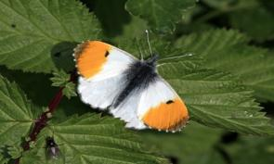
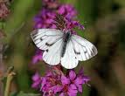

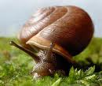


Bats and Insects
-The most abundant creatures at Roundball Wood are insects.
-There are hundreds of mini-beasts to search too, summer and spring are the best searching times.
-Some of the butterfly species include: Meadow Brown, Green veined white, common blue & small skipper.
-Many moths also patrol the woodland including: large yellow under wing, jersey tiger & six spot burnet.
-The best time to see them is early evening during summer.
Surveys have shown that at least 4 different species of bat use the Roundball Wood for foraging and possibly roosting. These species are: The Common Pipistrelle, Soprano pipistrelle, Brown Long-Eared and the Serotine bat.
In the UK we have 16 species of bat, all of which occur in Devon.
-They use echolocation to navigate and hunt using ultrasonic calls which are impossible for humans to hear.

Slide 11
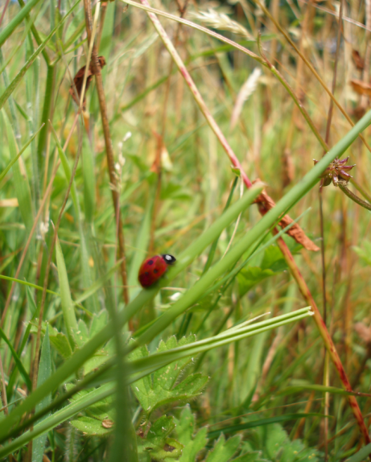
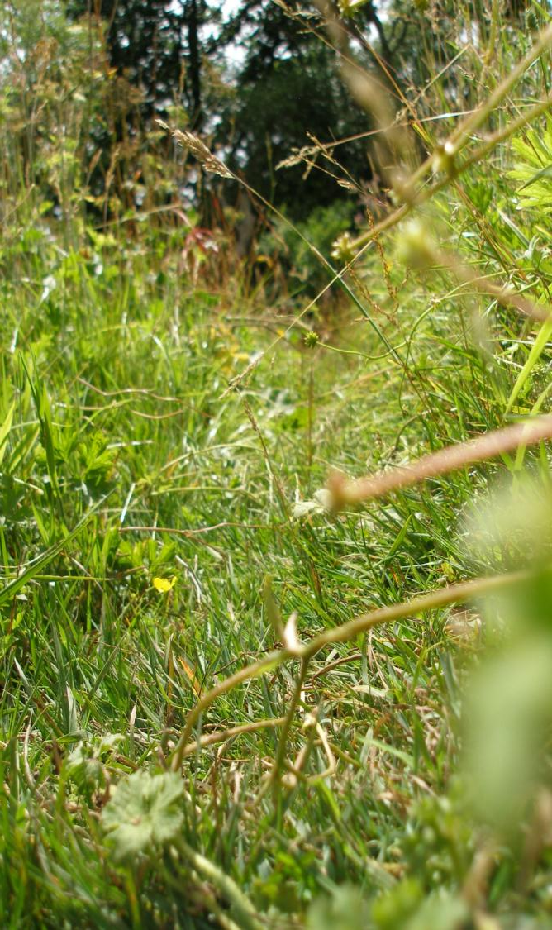
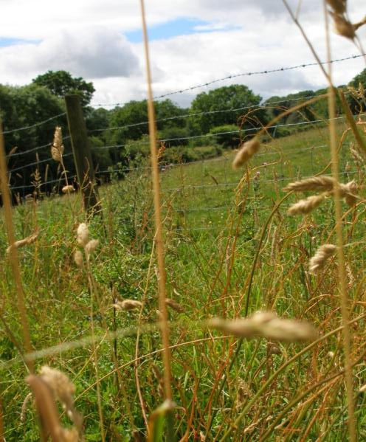
Roundball Wood
is
-Beautiful
-Incredible
&
-Outstanding
So why not have a look?

Slide 12
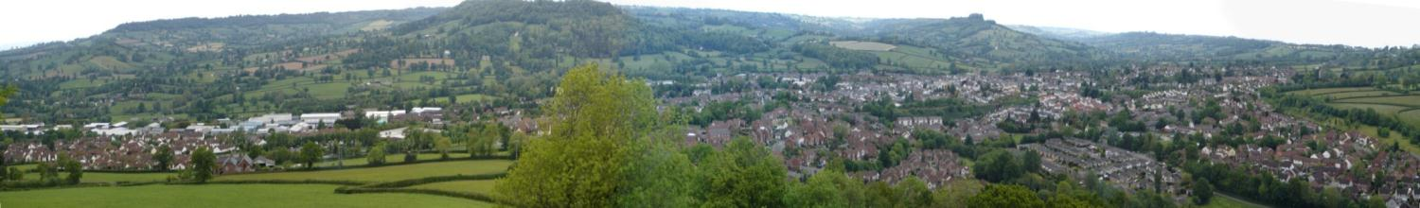
Roundball Hill
As you continue your walk around the wood you come to Badger’s Beech.
Further on you’re greeted with a path to your left and a kissing gate on the right. The gate leads to Roundball Hill. Please go and have a look at the astounding views.
Climb to the summit of the hill and you discover fantastic views from all angles. You can see right over Honiton and across to the Blackdown Hills AONB.
Roundball Hill is geologically part of the Blackdown Hills plateau.
It is not a round dome shaped hill as it’s name suggests but it is in fact a long narrow ridge extending north.

Slide 13
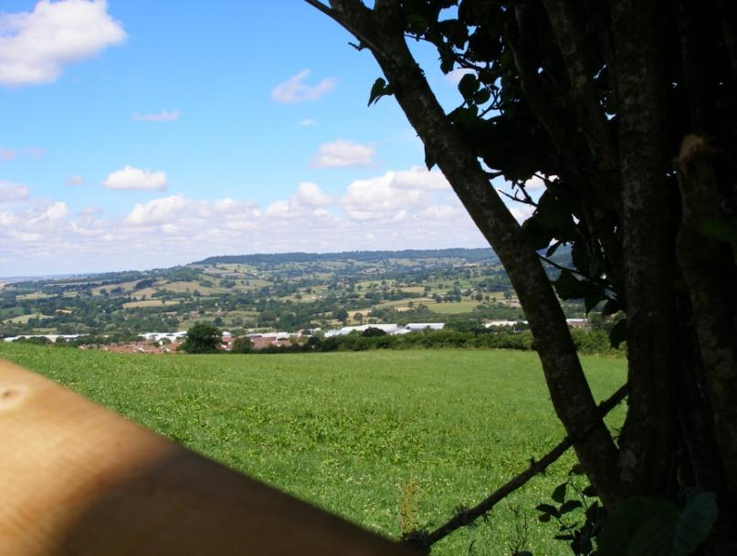
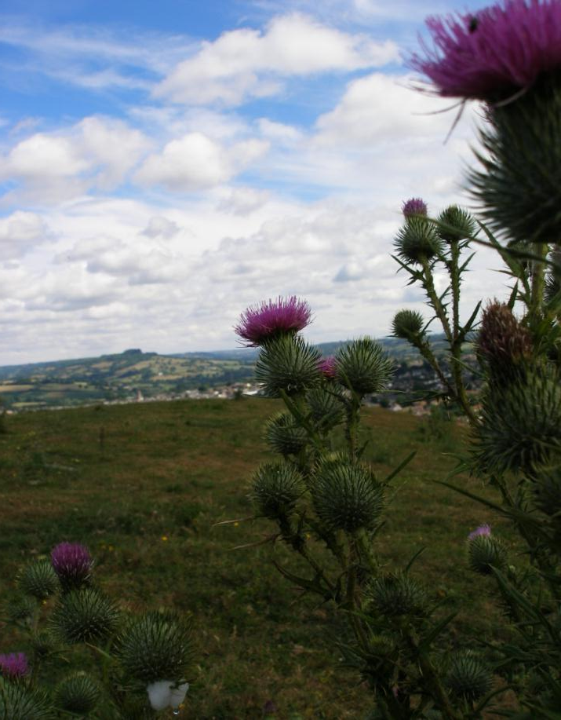
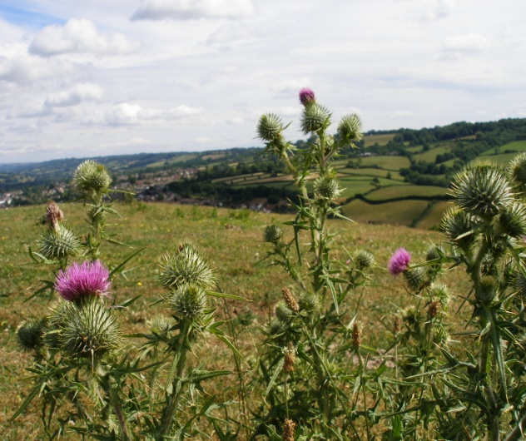
The following slides contain
pictures taken from Roundball Hill.
All photographs by: Hannah Jenkins

Slide 14
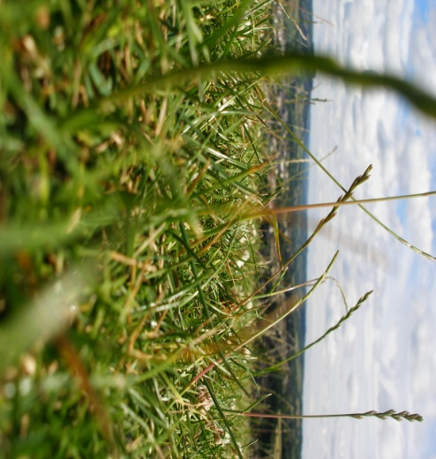
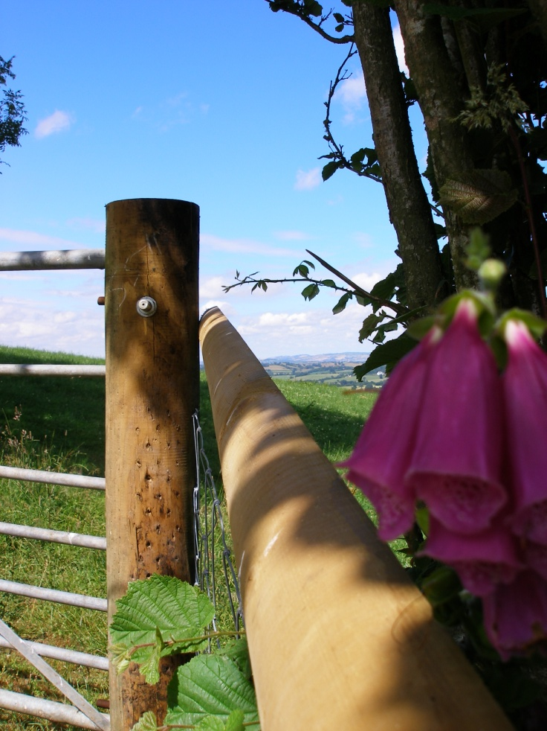
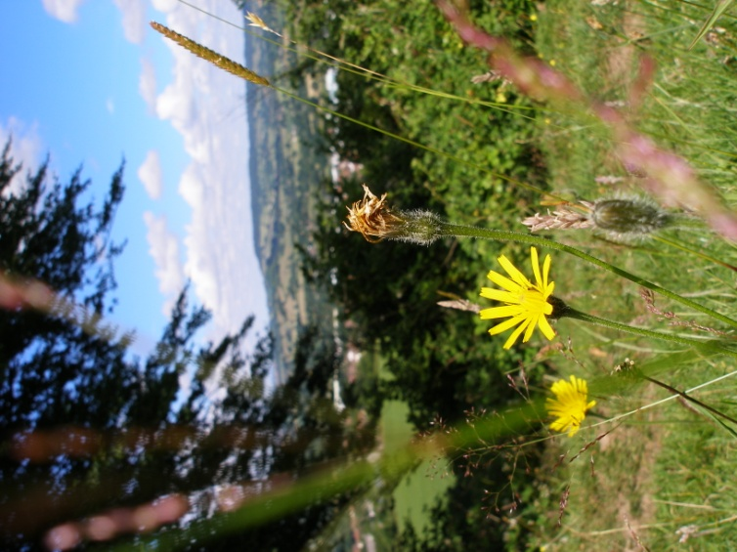

Slide 15
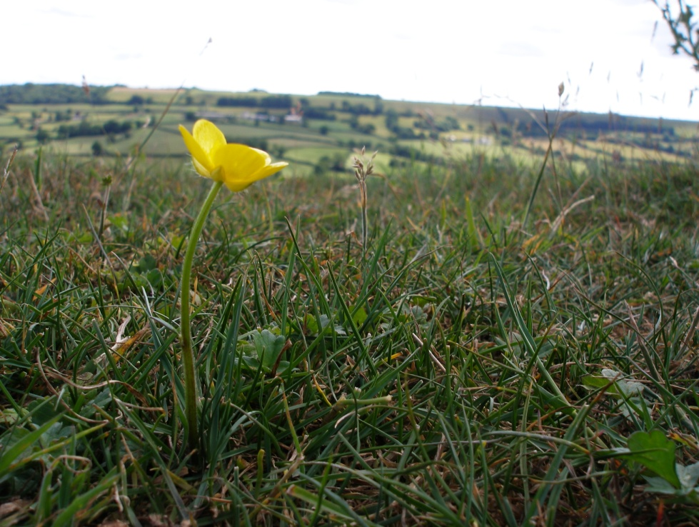

Slide 16
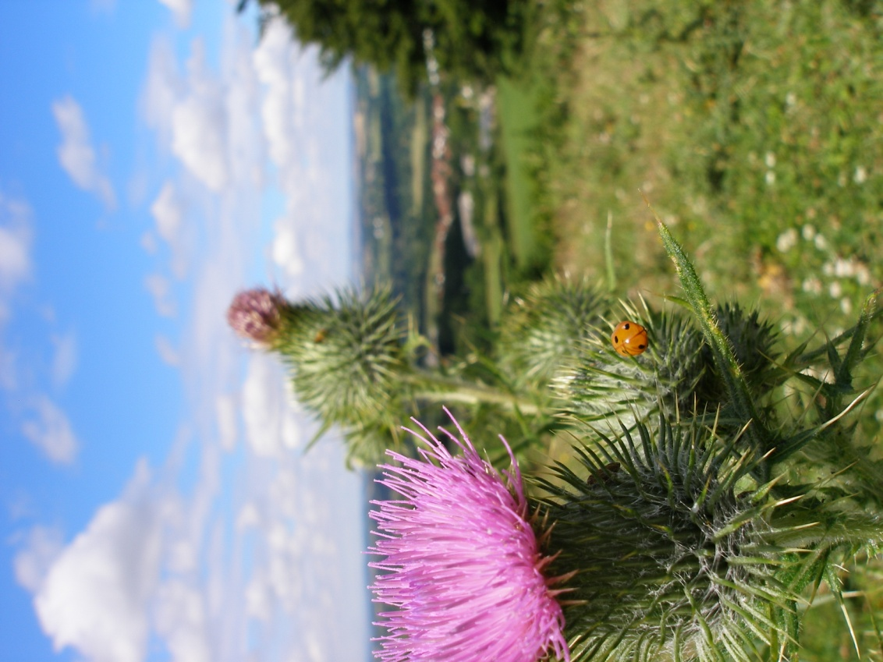

Slide 17
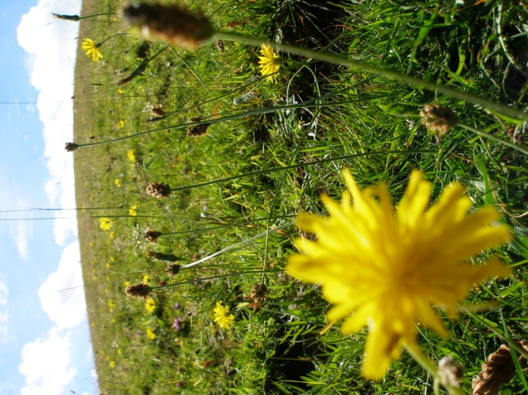


Slide 18
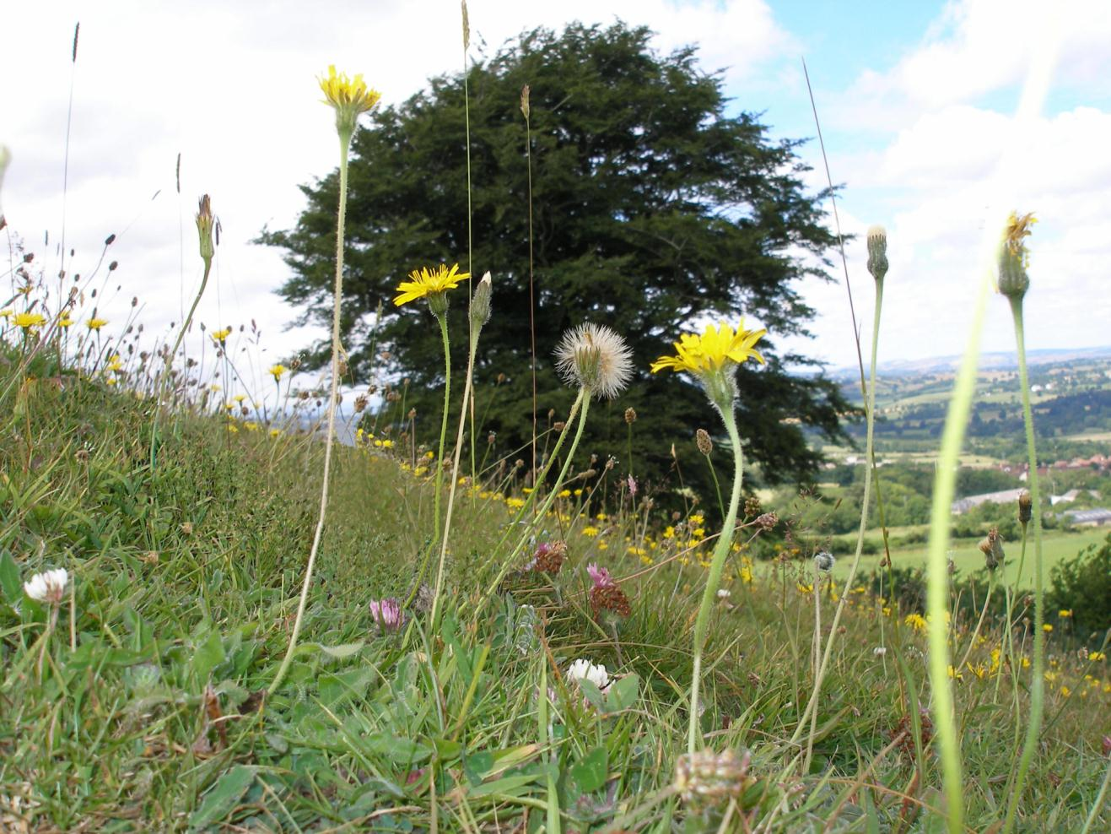

Slide 19
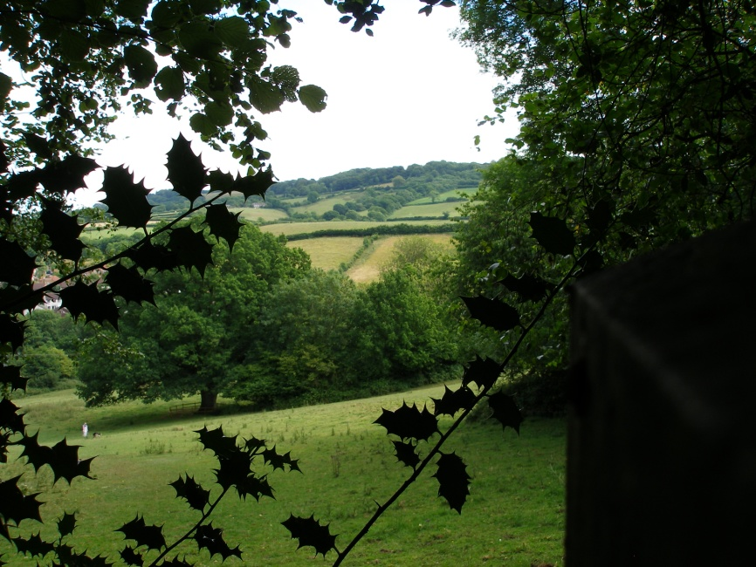
If you then return to the wood you continue your journey through a maze of Badger houses and then a leafy footpath through a crowd of Ferns. This then leads you past the fallen birch tree and towards the field where you entered.
The following photographs are taken by Hannah Jenkins from around the wood.

Slide 20
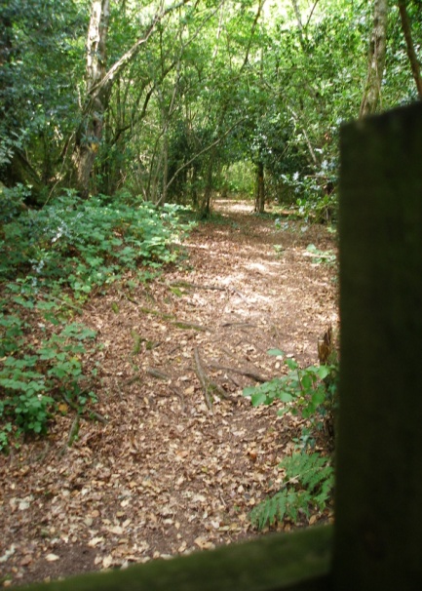
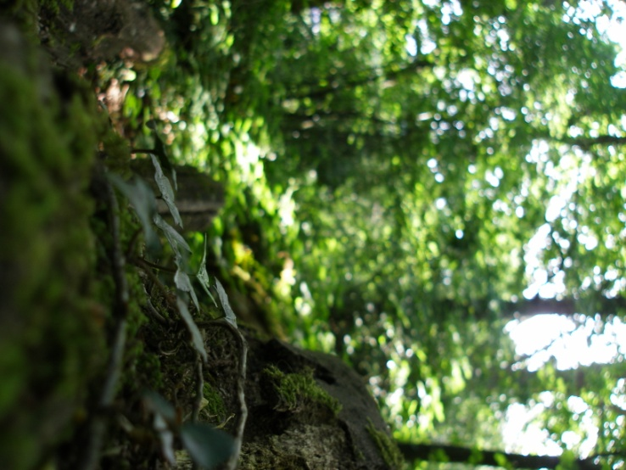

Slide 21
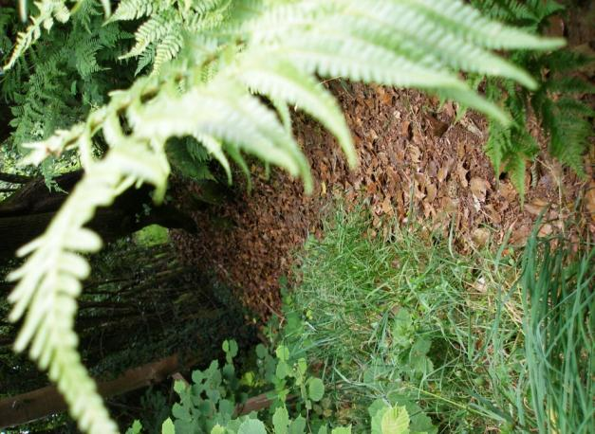
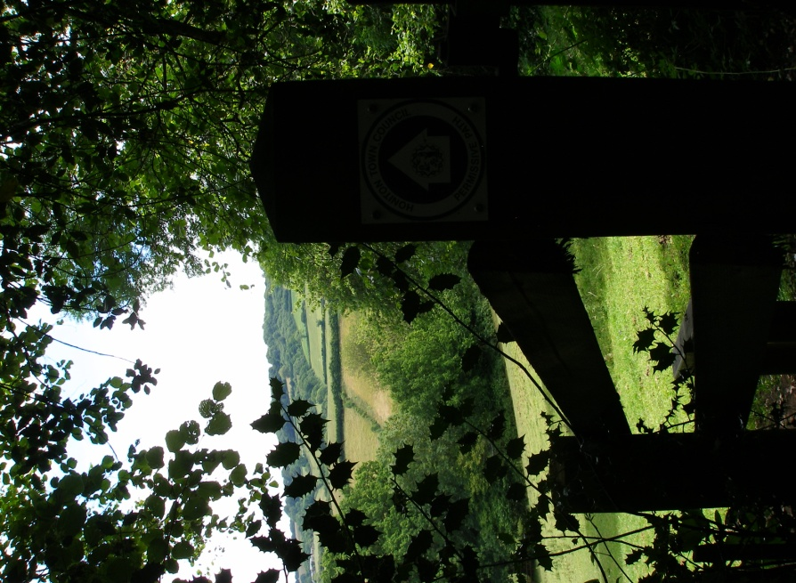
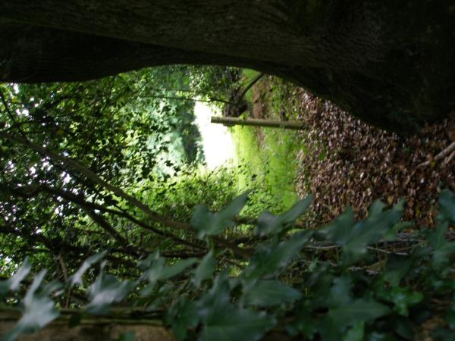

Slide 22




Slide 23



Slide 24



Why?
Please don’t leave litter around.
It’s an eyesore, it’s a danger to people and animals and it ruins the environment!
You are welcome to take a picnic and walk your dogs as long as you clear up after yourselves and keep dogs on leads.
The wood is not suitable for wheelchairs, buggies or anything similar. Also please keep to the marked paths to avoid injury or damage to the ecosystem and wildlife.
Roundball Wood is a fantastic place so lets keep it that way; together!

Slide 25




Thank you
With thanks to:
-East Devon Area Of Outstanding Natural Beauty
For paying for the information boards
-The Wood Wardens
For the upkeep of the wood and paths
Hannah Jenkins (15) for producing this PowerPoint for...
-Honiton Town Council

Slide 26


